Slide 1


Day 26
contact@anubhavtrainings.com
ABAP RESTFUL APPLICATION PROGRAMMING

Slide 2

Agenda – Day 26
What is EML ?
Why we use EML
Syntax of EML
C-R-U-D Using EML
Implementation of EML

Slide 3
What is EML ?
The Entity Manipulation Language (EML) is a part of the ABAP language that enables access to RAP business objects. Because the consumption of business objects via the OData protocol requires a Fiori UI or a web API, EML enables a type-safe access to business objects directly by using ABAP.
A Business Object in RESTful ABAP is consists of multiple Entities. This is a entity composition tree with one entity acting as a root. EML is part of the ABAP language and used in context of RESTful ABAP to control the BO behavior (create, read, update, delete).
We can use the EML in ABAP to test our BO. We can call the BO using EMP from ABAP program in 2 ways
01
Standard (Statically)
Generically (Dynamic) framework.
02

Slide 4
Syntax of EML
The EML provides us 3 important access statements for Data Manipulation using BO( Business Object ).
01
Perform the CUD ( Create ,Update ,Delete on BO
MODIFY ENTITIES OF RootEntityName
ENTITY EntityAliasName
[ CREATE FROM it_instance_c ]
[ UPDATE FROM it_instance_u ]
[ DELETE FROM it_instance_d ]
[ CREATE BY \AssociationName FROM it_instance_cba ]
[ RESULT et_result_tab ] [ FAILED failed ] [ REPORTED response ] [ MAPPED mapped ]
02
Commit Entities
Will actually persist the changes in the DB from transaction buffer. Any modify operation that are executed within behavior pool or by ABAP program are not causing any DB change because they are applied on transaction Buffer and this buffer content will disappear when ABAP session ends. So if we want the changes to be passed to SAVE SEQUENCE and persisted, we will use the COMMIT ENTITIES statement.
finalize ( )
check_before_save( )
Adjust_numbers( )
Save( )

Slide 5
Syntax of EML
03
Read the Data
All operations that do not need to change the data of an entity are carried out by READ Data.
There 2 types of Read
Read Entity by Key
Read Access to child (association) by parent key
Read Statement always returns the RESULT and you must specify target variable. We can also read the associated entity data using BY \asso_name FROM it_table syntax.
The result of associated data with come in another internal table LINK tab_name, it will always contain the key value pair.
READ ENTITIES OF RootEntityName
ENTITY EntityAlias FROM it_read_condition
RESULT et_result
BY \asso_name FROM it_read_rba
RESULT et_res_rba
LINK et_link_keys
ENTITY EntityAlias FROM it_ins_2…. [ FAILED failed ] [REPORTED reported]

Slide 6

Rule for EML
In addition to the data we also have a compiler generated field in input and output results called %control, this field is responsible to inform the RESTful framework that, which are all the fields we would like to send to DB while creation or update while updating. Also while read we can specify the same to avoid reading everything.
We can also see the complete BO structure in BO Explorer using keyboard shortcut
Alt+Shift+W

Slide 7
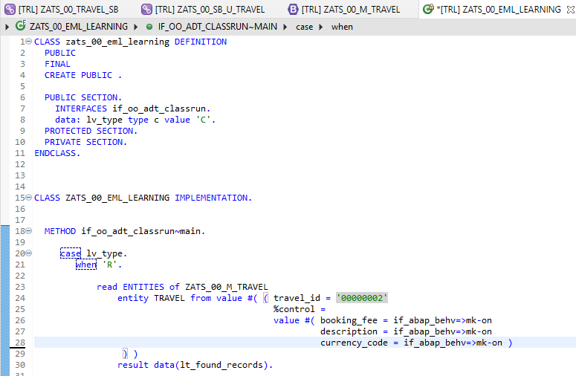
Implementing EML
Exercise
ZATS_00_EML_Learning

Slide 8

End of Day 26
Trainer: Anubhav Oberoy

Slide 9

Trainer: Anubhav Oberoy

Slide 10
THANK YOU
If you cannot do
great things, do small things in a great way.
Anubhav Oberoy
https://www.anubhavtrainings.com

Slide 11


We’re committed to empower you to be
Most Desirable Resource
through powerful training solutions.
We build the workforce of the future.
250+
Corporate Clients
30,000+
Learners Trained
25000+
Learners Placed
FREE WEBINARS
Sign up for free webinars with industry experts every fortnight!
Enroll Now!
Contact us today!
https://anubhavtrainings.com/

Slide 12




More from AnubhavTrainings.com

